Slide 1
CS4499/5599: Data Science and Applied Machine Learning
Class Lecture: March 15th, 2023

Slide 2
Objectives
Last time:
Went over the concept of classification
Discussed how to evaluate classification models
Introduced Decision Trees
Today:
Finish our Decision Tree example
Discuss the midterm project
Discuss regression with decision trees (as time permits)

Slide 3
Midproject
This assignment is designed to test your ability to prepare data and train a simple classification model
This assignment is more involved than our previous homework assignments, so you will have until April 5th (3 weeks) to complete the assignment
This will likely take some time, so start working early
This assignment is worth 20% of your grade, so take it seriously
Late projects will be accepted with the normal penalty
The TA and myself will try and address questions

Slide 4

Midproject
Your goal in this project is to develop a model that predicts if the home team in the NBA will win their game
This is a similar idea that odds-makers use to make their own predictions
Now that many states are allowing betting on sports, this is an interesting topic to examine

Slide 5
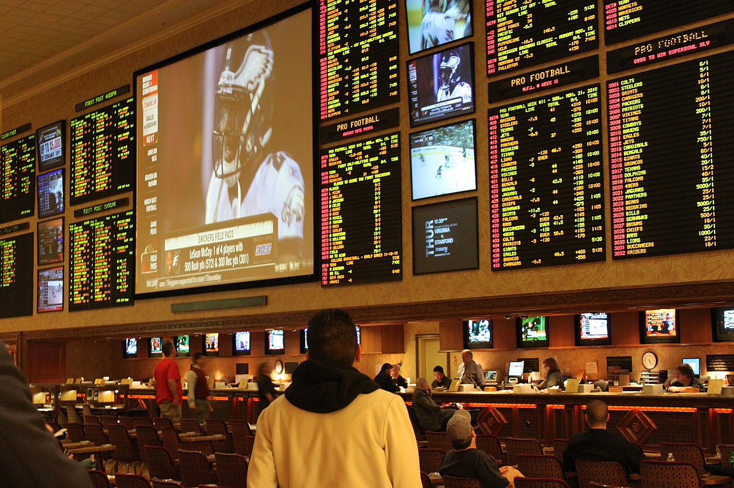
Midproject
Remember odds makers (namely casinos) use several, very complex models and criteria
Odds are your model will not actually be effective in real life (I would NOT recommend trying it)
The goal of this project is to practice the process of putting together data and training a model
Your grade is based on this, not the performance of the model

Slide 6
Decision Tree Regression
Decision tree are one of the classification models that can also be used for training regression models
Remember the goal of regression is to determine a value
The concept is the same, we still are looking to split down our data into small pieces until we have a definitive answer
The difference is how we use our equation (CART if we are using Gini Impurity or ID3 if we are using Entropy)
With regression decision trees we calculate MSE for both paths down the tree (we can have more, if we want)

Slide 7
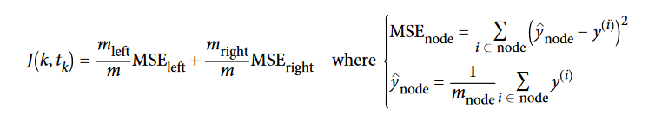
Decision Tree Regression
The goal is to minimize the MSE instead of the impurity
The CART algorithm uses the cost function following equation:
Regression decision trees have the same pros and cons as classification trees
This includes the tendency to become overfit easily and require tuning to produce better models

Slide 8
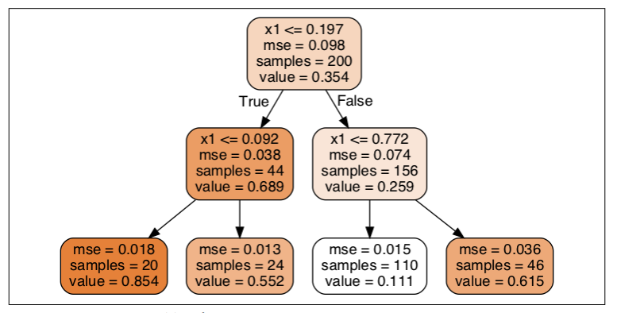
Sample regression tree plot
Notice that each node predict a value
Assume we have a x1 value of 0.6. What is the predicted value?
This is the average target value of the number of samples
Notice we also have a validation value to work with as well (MSE)
Source: Geron textbook

Slide 9
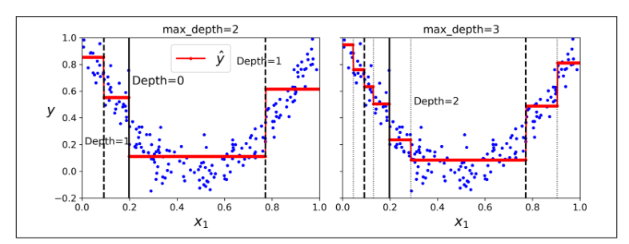
Decision Tree Regression
Let’s look at a graph of the predictions:
The prediction is always the average target value of the points in that region

Slide 10
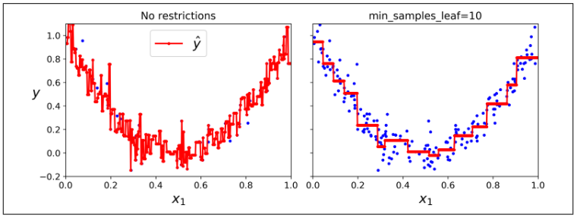
Decision Tree Regression
Now let’s compare an overfit regression model with a “pruned” model:
Just as was the case with linear regression, we don’t want major fluctuation

Slide 11
Next Time
Continue discussing classification in machine learning
Discuss the concept of ensemble models
Random Forest (both regression and classification)
Remember the midproject is due on 4/5
Have a great spring break!

